Slide 1
Controlling Multithreaded Applications Part 2
SET10108 Concurrent and Parallel Systems

Slide 2
Breakdown
Futures
Atomics
C++ Memory Model

Slide 3
Futures

Slide 4
Background Tasks
So far we have covered basic threading concepts
Thread creation
Waiting for threads to complete
Locking
Waiting on locks
What we haven’t looked at yet is the concept of background tasks
Send of some work to be done
Get the result when the work is completed
Our threads are very much fire and forget
Shared memory is used for communication

Slide 5

Example – Network Connections
A classic example of background processing is a network server
A network server may receive multiple incoming connections
Each connection has to be serviced when data is available
Naïve method is to have a thread for each connection
Better method is to have a background process to service connections as necessary

Slide 6
Futures
Futures are a technique to send off some work to be done and return to get the result later
A future spawns a thread to undertake the task
Our creation thread continues working
At some point the creation thread tries to get the result
Waits if not ready
Result given if it is ready
future<unsigned int> f = async(find_max, values, 0, 1000);
// Do something else
unsigned int result = f.get();

Slide 7
std::async in C++11
To create futures, C++11 introduces the std::async function
auto f = async(function<type>, params…);
The type returned by async is a future based on the function type
future<type> f = async(function<type>, params…);
Otherwise, we treat everything just like a thread
Pass in a function (or a lambda expression)
Pass in necessary parameters
The main difference between a thread and a future is that we are returning a value

Slide 8
Promises
A further mechanism we can use with futures is the idea of promises
A promise allows us to send data to a future
We are promising it the data
A future can wait for the promise to be made, and then complete
The result is returned
This provides a nice mechanism of communication
Called a promise-future pair

Slide 9
Waiting with Futures and Timeouts
As with standard waits, we can also wait on a future with a timeout
Futures provide mechanisms to wait for or wait until a defined time
Consider a future
auto f = async(blah);
It provides a method to wait for a time duration
if (f.wait_for(time) == ready) // complete work with future
Again, this is about control flow
Are you happy to wait for a value to become ready
Would you prefer to process something else while you are waiting

Slide 10
Functional Programming with Futures
Let’s go back to lambda expressions
Because you all love them
Functional programming is becoming quite popular again, and futures are a model that functional programmers understand
We can build map-reduce applications using these techniques – we will do this using MPI and distributed parallelism
A function can create and call a future
Which can create and call a future
etc.
This allows a functional style to concurrency if necessary

Slide 11
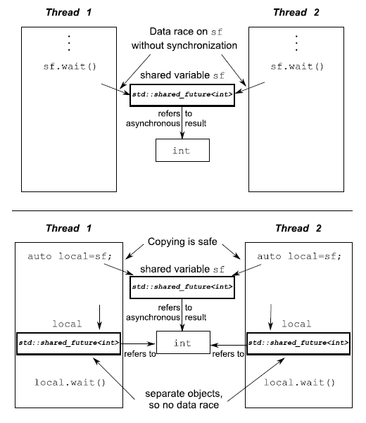
Shared Futures
Standard futures can only be accessed by one thread
Any the result only acquired once
If you want to share a result amongst multiple threads / functions use a shared future
Create a local copy
Get the result

Slide 12
Atomics

Slide 13
What do we mean by Atomic?
What does the term atomic mean to you?
In concurrency, atomic refers to an operation that happens as a single step – it cannot be divided by time slicing
For example, consider the counter example
Three operations
Get
Increment
Store
Why not one operation - atomic
Get-increment-store

Slide 14
Atomic Types
C++11 introduces a number of atomic types
Atomic types have atomic operations defined
Pretty much anything can be an atomic type
Primitive data, pointers, etc.
But the operations depend on the type
atomic<bool>
atomic<int>
atomic<float>
atomic<char>
atomic<char*>
atomic<my_object>

Slide 15
Atomic Operations
The main point of atomics is that we have special operations
These operations will not be divided when we call them
Some CPUs actually support atomic operations – better performance
All data types support load, store, exchange
In general, integral types support the others
More in C++ Concurrency in Action
load
store
exchange
fetch_add
fetch_sub
fetch_or
fetch_and
fetch_xor
++, --

Slide 16
Atomic Flag
A nice type that C++11 supplies (and is CPU supported) is the atomic flag
Atomic flag has two operations
test_and_set – returns true if flag is available, false otherwise
clear – clears the flag
Atomic flags are fast – but they do not enable waiting
There is a no lock
while (flag->test_and_set());
// Flag is available. Thread displays message
cout << "Thread " << id << " running" << endl;
// Sleep for 1 second
this_thread::sleep_for(seconds(1));
// Clear the flag
flag->clear();

Slide 17
Why not Atomic Boolean?
A question you might ask is why have atomic<bool> and atomic_flag
To understand this, you need to realise what a Boolean is in memory
C exposes this, C++ now hides it
Does anyone know how a Boolean is stored?
A Boolean is just a byte of data (the smallest chunk of data) which has either 1 stored (true) or 0 stored (false)
A better question might be why do we need atomic<bool> and atomic<char> (C++ has no byte type – char is closest)
Atomic flags are most likely to be supported by the CPU

Slide 18
Building a Spin Lock Mutex with Atomic Flags
We can create a spin lock easily with an atomic flag
We spin waiting for the flag to be clear
See the lock function
When we unlock we clear the flag
We could use this busy mutex in our lock guards
Simple non-blocking but has problems
class spinlock_mutex
{
std::atomic_flag flag;
public:
spinlock_mutex(): flag(ATOMIC_FLAG_INIT){}
void lock()
{
while(flag.test_and_set(std::memory_order_acquire));
}
void unlock()
{
flag.clear(std::memory_order_release);
}
};

Slide 19
C++ Memory Model

Slide 20
Why are we interested in the memory model?
One of the strengths of C++ is that we are working in a systems language
Data created is stored in memory in an almost one to one mapping
We can access memory directly and manipulate it in particular ways
Operations are very close to how the CPU operates
We therefore need to think sometimes about how data is accessed and stored in C++ applications when dealing with multithreading
Between two operations anything could happen – we need to control and understand this

Slide 21
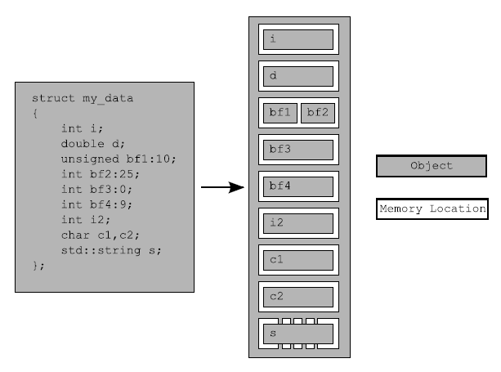
C++ Data Structure
C++ structs (and therefore classes) store data as a continuous chunk
Order of declaration matters
There is almost a direct mapping between declaration and memory locations
It therefore is important to realise how data is constructed when thinking about order of operations

Slide 22
Synchronisation and Enforcing Order
We are going to look at how we can do some low level control of operations
We are really trying to ensure that little gotchas don’t occur in our applications
You will be surprised where they can occur
Our job as concurrent systems programmers is to fully understand the order of operations and access to our data
We are removing nondeterminism

Slide 23
Call Ordering
What is the output from the following application?
Actually it depends
It could be 1, 2
It could be 2, 1
This is for just a single threaded application
For multithreaded we really have to think about what is going on
void foo(int x, int y)
cout << x << “,” << y << endl;
int get_num()
static int i = 0;
return ++i;
main
foo(get_num(), get_num());

Slide 24
Memory Ordering
There are three models of memory ordering in C++
Sequentially consistent ordering
Acquire release ordering
Relaxed ordering
These are supported in certain operations using the following
memory_order_seq_cst
memory_order_consume, memory_order_acquire, memory_order_release, memory_order_acq_rel
memory_order_relaxed
Remember your caches here – memory in one cache might not be our current value

Slide 25
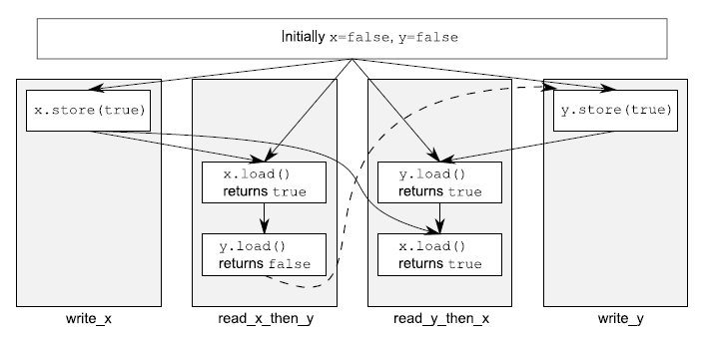
Sequential Consistent Ordering
Sequential consistent ordering is the easiest to understand
Operations occur in a strict order based on operation calls
This means we have some notion of reason on the output
This is the default method – it has an overhead however

Slide 26
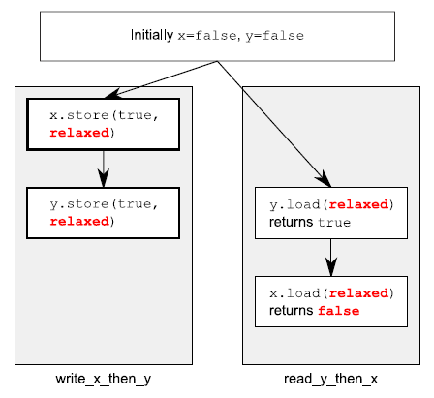
Relaxed Ordering
Here there is less control over the order
Loads and stores don’t happen in a specific order
This means you don’t necessarily see the current value of a variable
You won’t see any older values than you have previously seen though

Slide 27
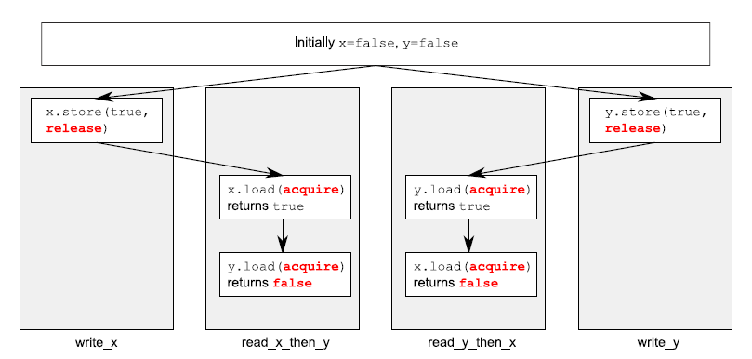
Acquire Release Ordering
This overcomes some of the problems with relaxed ordering
There is some notion of order between a release and acquire
We can check if we have the last value loaded
However we still don’t have the strict sequencing to control everything

Slide 28
Memory Ordering
How these methods are supported depends on the CPU
Modern CPUs based on x86 and x86-64 are fine here
The reasons we use these are to gain performance at a fine grained level
If we know and can understand the order of operations required, we can gain some performance tuning
The default is sequential consistency

Slide 29
Fences
We can overcome some of the problems of relaxed ordering using fences
Fences are global operations to control ordering of atomic operations
Sometimes referred to as memory barriers
These are getting down to low level considerations – we won’t delve any further
You need to be aware in C++
We will look at memory considerations again when doing CPU parallelism

Slide 30
Summary
We have looked at two ends of the spectrum here
High level abstractions using futures
Low level abstractions using atomics
Futures are really just a step beyond threading – this should be easy to understand
Working with atomics sometimes requires thinking about your memory
Optimisations for memory ordering

